Slide 1

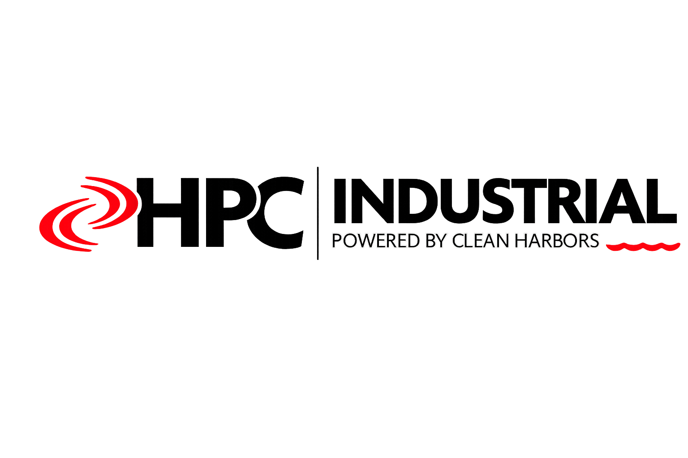
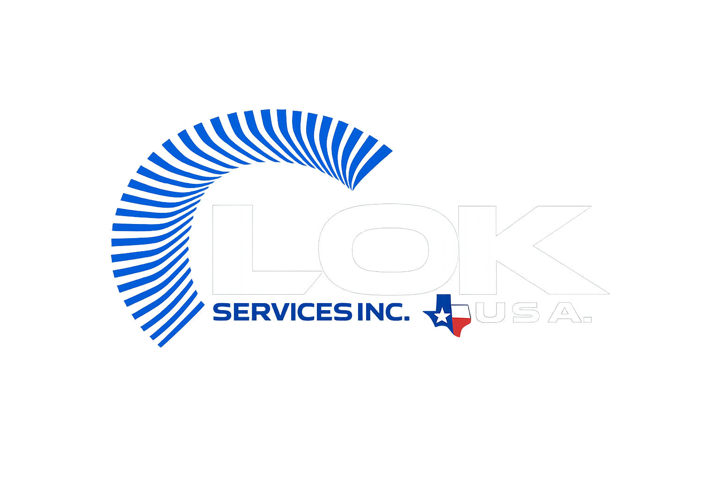
Prepared for Our Valued Partner:
“We Don’t Just Bring Services, We Offer Solutions”

Slide 2
OUR PEOPLE MAKE THE DIFFERENCE
Pumps & Compressors
SERVICES & CAPABILITIES
Your Trusted Industrial Field Service Provider
Shutdown & Turnaround
Installation & Commissioning
Field Maintenance
From generators to chemical cleaning, pipeline services, and complete shutdown & turnaround management — LOK Energy Services delivers precision execution across every phase of your operation.
Industrial Staffing
Chemical Cleaning
TECHNICAL BRIEF
Pipeline Services
lokenergy.com · charles@lokenergy.com · +1 (832) 781-1644 · Houston, TX · Calgary, AB

Slide 3

ABOUT LOK ENERGY SERVICES
TECHNICAL BRIEF
Who We Are
THE LOK DIFFERENCE
20+
2
LOK Energy Services has been the trusted provider of high-quality mechanical and field services to renowned OEM and industrial companies for more than two decades worldwide.
Years of Experience
Continents
Our highly skilled team of certified Intstallers, engineers, and field specialists consistently proves their dedication and expertise — earning the unwavering trust of clients day in and day out.
7+
24/7
We customize every engagement. Whether it's a planned shutdown, an emergency repair, or a complex chemical cleaning operation, LOK tailors its approach to the specific needs of your facility.
Industries Served
Emergency Support
INDUSTRIES WE SERVE
Our commitment: top-quality, cost-effective solutions with swift response times — giving OEM and industrial companies the peace of mind to support their end-user clients with confidence.
▸ Oil & Gas
▸ Oil & Gas
▸ Pulp & Paper
▸ Petrochemical
▸ Petrochemical
▸ Mining
▸ Power Generation
▸ Power Generation
▸ Agriculture
▸ Manufacturing
▸ Manufacturing
LOK Energy Services Inc. · lokenergy.com · charles@lokenergy.com · +1 (832) 781-1644

Slide 4
FULL-SERVICE PORTFOLIO
TECHNICAL BRIEF
All Services At a Glance
One partner. Every phase of your operation.
1
Chemical
Remediation
2
Pumps &
Compressors
3
Shutdown &
Turnaround
Hydrocarbon Spill Response
PH2S & Hazardous Gas Mitigation
Maintenance & Overhauls
Alignment & Balancing
PM Planning & Scheduling
SAP Build & Scheduling
Tank and Pipeline Decontamination
Soil and Groundwater Remediation
Mechanical Seals
Emergency Response
Manpower Loading
Materials Procurement
Produced Water Treatment
Chemical Injection and Neautralization
Vibration Analysis
Performance Optimization
Execution Readiness
Swift Mobilization
4
Installation &
Commissioning
5
Field
Maintenance
6
Industrial
Staffing
Rotating Equipment Install
Pre-startup Inspection
Chemical Cleaning ★
Welding & Pipefitting
Certified
Short & Long-term Contracts
Precision Alignment
Equipment Qualification
Hydroblasting
Millwrighting
Field Specialists
Technical Supervision
System Commissioning
Performance Verification
Pipeline Services
Preventive & Predictive Maint.
Craft Labor Deployment
Safety-Qualified Personnel

Slide 5
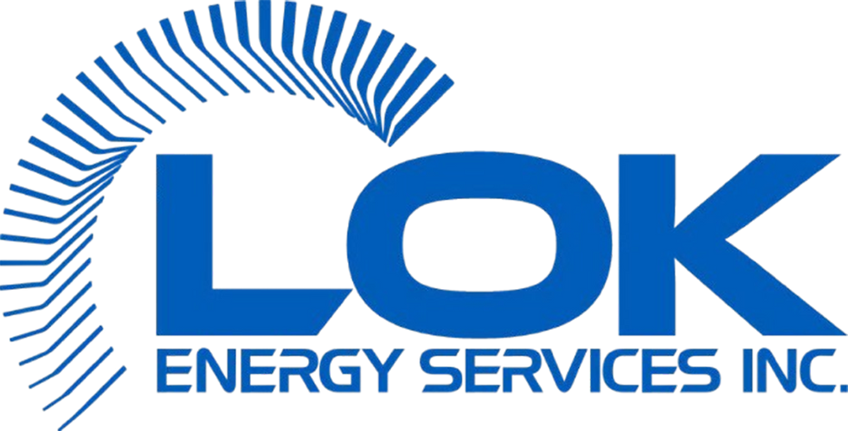
FEATURED SERVICE
FULL-SERVICE REMEDIATION
TECHNICAL BRIEF
Chemical Cleaning & Remediation
More than chemical cleaning — integrated remediation support from access through restart
WHAT IT IS
THE LOK PROCESS
Chemical cleaning uses engineered chemical solutions to remove deposits, scale, corrosion, hydrocarbons, and biological fouling from process equipment, pipelines, heat exchangers, vessels, and reactors — restoring flow efficiency, heat transfer performance, and structural integrity.
01 Access & Isolation
02 Pre-Cleaning Assessment
Heat Exchangers
Pipelines
Vessels & Reactors
Compressors
Boilers
Scale & fouling removal
Wax, scale, biofilm removal
Corrosion & deposit removal
Hydrocarbon & varnish removal
Scale removal & passivation
03 Chemical Application
04 Circulation & Soak
WHY CHEMICAL CLEANING IS CRITICAL
05 Flushing & Neutralization
Fouled equipment costs energy, reduces throughput, accelerates corrosion, and creates safety risks. Regular chemical cleaning reduces operating costs, extends asset life, ensures compliance, and enables full turnaround efficiency — making it foundational to every LOK maintenance program.
06 Inspection & Restart
LOK Energy Services Inc. · lokenergy.com · charles@lokenergy.com · +1 (832) 781-1644

Slide 6
SERVICE DEEP-DIVE ·
TECHNICAL BRIEF
PUMPS & COMPRESSORS
Precision Rotating Equipment Services for Maximum Uptime
LOK's pump and compressor teams deliver expert mechanical services for all rotating equipment types — from centrifugal and reciprocating pumps to high-pressure compressor systems across oil & gas, petrochemical, and power generation facilities.
Maintenance & Overhauls
Mechanical Seal Service
Vibration Analysis
Comprehensive maintenance programs and full overhauls covering disassembly, inspection, component replacement, and reassembly to restore peak performance.
Replacement and repair of mechanical seals across all pump configurations — preventing leaks, reducing downtime, and extending asset life.
Advanced vibration monitoring and analysis to detect imbalance, misalignment, bearing failures, and resonance before they cause costly breakdowns.
Alignment & Balancing
Emergency Response
Performance Optimization
Precision shaft alignment and dynamic balancing services that reduce wear, eliminate vibration, and extend the operational life of pumps and compressors.
24/7 emergency mobilization for pump and compressor failures — rapid diagnosis and repair to minimize production disruption and revenue loss.
Engineering analysis and modifications to optimize pump and compressor efficiency, flow rates, and energy consumption for your specific operating conditions.
LOK Energy Services Inc. · lokenergy.com · charles@lokenergy.com · +1 (832) 781-1644

Slide 7
SERVICE DEEP-DIVE · 03 OF 06 · FIELD MAINTENANCE SERVICES
TECHNICAL BRIEF
FIELD MAINTENANCE SERVICES
Customized Plant Performance Solutions for Sustained Success
LOK's field maintenance team provides 24/7 support across preventive, predictive, and corrective maintenance — plus specialized services including chemical cleaning, hydroblasting, pipeline work, welding, and millwrighting.
Chemical Cleaning ★
Hydroblasting
Pipeline Services
Engineered chemical solutions for removal of scale, fouling, and deposits from process equipment — core to every turnaround program.
High-pressure water jetting for surface preparation, tube cleaning, and deposit removal — effective where chemical cleaning is not applicable.
Inspection, maintenance, cleaning, and repair of process piping systems — including pigging, leak testing, and integrity assessments.
Preventive Maintenance
Predictive Maintenance
Welding & Pipefitting
Scheduled inspections and servicing to prevent failures before they occur — with custom maintenance plans aligned to your facility and schedule.
Data-driven monitoring using vibration analysis, thermal imaging, and oil analysis to predict and prevent equipment failures proactively.
Certified welding and pipefitting services for fabrication, repair, and installation of process piping and structural components.
Millwrighting
Industrial Grouting
Torquing & Tensioning
Expert millwright services for precision installation, alignment, and maintenance of industrial machinery and rotating equipment.
Precision grouting for machinery baseplates, anchor bolts, and foundations — ensuring proper load transfer and equipment stability.
Hydraulic bolt torquing and tensioning services ensuring proper flange integrity on critical process connections and pressure equipment.
LOK Energy Services Inc. · lokenergy.com · charles@lokenergy.com · +1 (832) 781-1644

Slide 8
SERVICE DEEP-DIVE · 04–05
TECHNICAL BRIEF
SHUTDOWN & TURNAROUND
INSTALLATION & COMMISSIONING
Precision planning and execution of planned shutdowns and turnarounds. With 20+ years of experience, LOK mobilizes swiftly, executes with discipline, and demobilizes efficiently — minimizing downtime at every critical juncture.
Expert precision installation and commissioning of rotating equipment to OEM specifications. LOK ensures every installation is performed right the first time — delivering reliable, efficient operation from day one.
PM Planning & Scheduling
Rotating Equipment Installation
Full preventive maintenance planning with detailed scheduling to align every task with your turnaround window.
Precision installation of turbines, pumps, compressors, and generators to exact OEM specifications.
Manpower Loading & Logistics
Precision Laser Alignment
Strategic crew planning, deployment, and logistics management ensuring the right people are in place at the right time.
Advanced laser alignment ensuring minimal vibration, reduced wear, and optimal mechanical efficiency.
Execution Readiness
System Commissioning
Pre-turnaround readiness reviews, tool preparation, permit coordination, and safety briefings.
Full commissioning verification — functional testing, performance checks, and sign-off procedures.
SAP Build & Scheduling
Pre-Startup Inspection
Work order creation, task list build, and scheduling within SAP to ensure full traceability and reporting.
Comprehensive pre-startup reviews to catch and correct issues before first operation.
Materials Procurement
Performance Verification
Sourcing, expediting, and managing all materials and spare parts needed for turnaround scope.
Post-installation performance testing confirming all equipment meets design specifications.
LOK Energy Services Inc. · lokenergy.com · charles@lokenergy.com · +1 (832) 781-1644

Slide 9
SERVICE DEEP-DIVE · 05 OF 05
TECHNICAL BRIEF
INDUSTRIAL STAFFING
The Right People, On Site, Ready Day One
LOK deploys certified Intstallers, field specialists, and craft labor to industrial facilities across the Gulf Coast and internationally. Every crew member is safety-qualified, technically proficient, and ready to perform from the moment they arrive on site.
ROLES WE DEPLOY
WHY LOK STAFFING
Certified Intstallers
1
Our core capability — precision installation, alignment, and maintenance of industrial machinery.
Every crew member is safety-briefed and compliant with site-specific requirements before day one.
Field Service Technicians
2
Specialized technical personnel for turbine, pump, and compressor service work.
Decades of hands-on experience across every major rotating equipment type and industrial process.
Pipefitters
3
Skilled pipefitters for fabrication, installation, and repair of process piping systems.
Short-term turnaround support or long-term embedded staffing — scaled to your exact needs.
Welders (Certified)
4
Certified welders for structural and process piping work across all materials and processes.
LOK crews can be mobilized to site quickly — reducing the gap between need and execution.
Technical Supervisors
5
Experienced supervisors who manage crew performance, safety compliance, and quality assurance.
Trusted by OEM companies worldwide for more than two decades of consistent field performance.
LOK Energy Services Inc. · lokenergy.com · charles@lokenergy.com · +1 (832) 781-1644

Slide 10
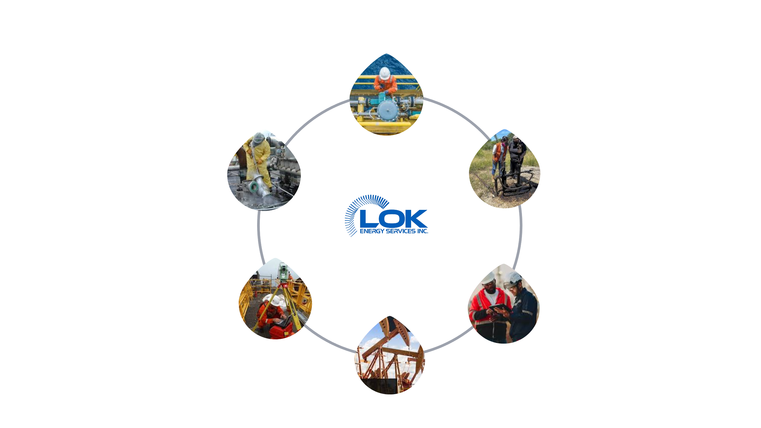

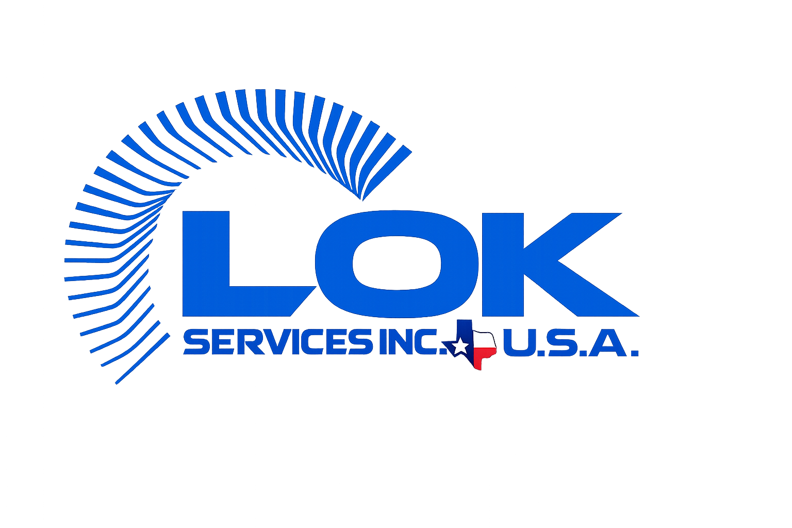
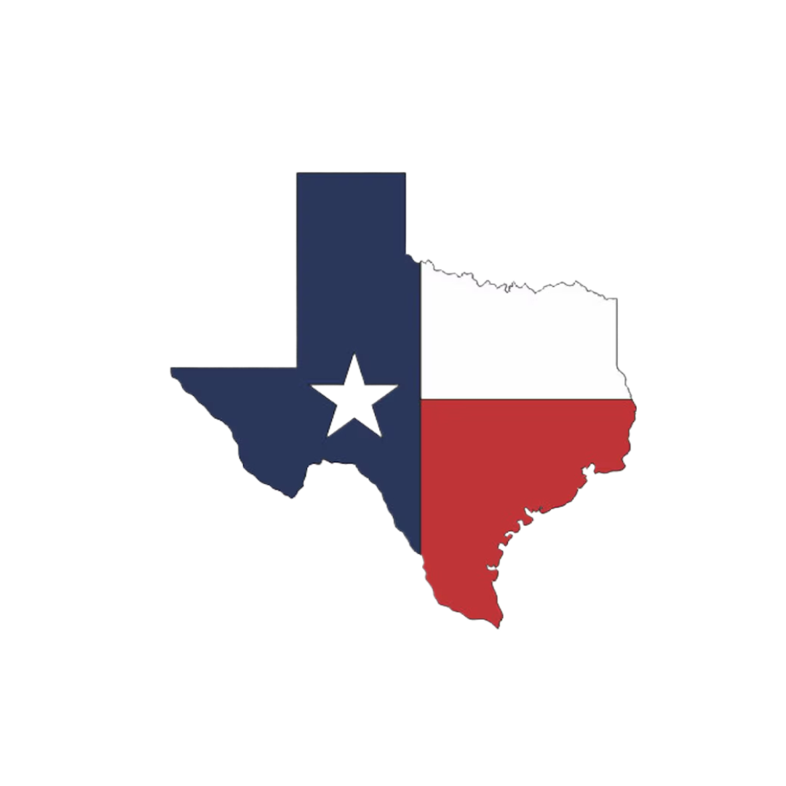
THE LOK INTEGRATED ADVANTAGE
TECHNICAL BRIEF
Shutdown & Turnaround
How Our Services Work Together
LOK is not a collection of isolated services — it's an integrated system built around one goal: keeping your facility running at peak performance.
Industrial Staffing
Chemical Cleaning
ONE PARTNER
EVERY PHASE
Turbines &
Generators
Installation & Commissioning
Field Maintenance
Pumps & Compressors
INTEGRATED EXECUTION: Turnaround planning triggers chemical cleaning scope · Staffing deploys with maintenance crews · Installation leads to long-term maintenance contracts · One call activates the full LOK capability stack

Slide 11
SAFETY
TECHNICAL BRIEF
Safety Is Not a
Program. It's Our Culture.
A zero-incident mindset governs every LOK engagement — from initial planning through final demobilization.
Pre-Job Planning
Permit Compliance
Every project begins with thorough hazard identification, JSA development, and safety briefings — ensuring every worker understands the risks and controls before work begins.
Strict adherence to all hot work, confined space, LOTO, and facility-specific permit requirements — no exceptions, no shortcuts.
PPE & Equipment Standards
Incident Reporting
All LOK personnel arrive with appropriate PPE and tools. We comply with site-specific requirements and exceed minimum standards.
Transparent near-miss reporting, incident investigation, and corrective action — learning from every event to continuously improve our safety performance.
LOK Energy Services — committed to sending every worker home safe, every day.

Slide 12
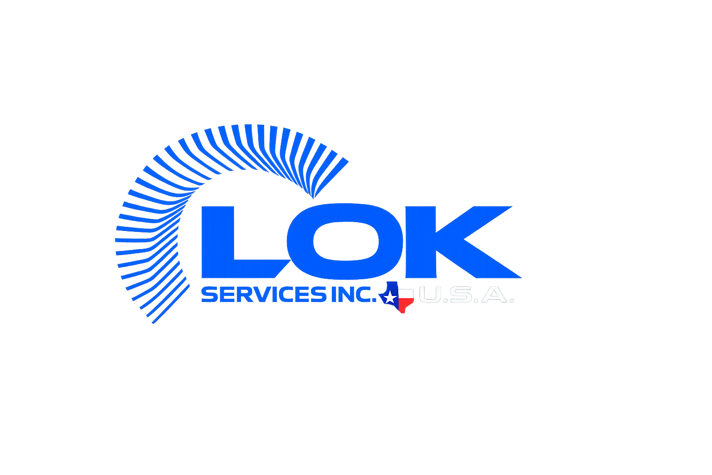
OUR FUTURE IS BRIGHTER TOGETHER!

Slide 13
OUR SERVICES
TECHNICAL BRIEF
Pumps & Compressors
Ready to Take Action?
Shutdown & Turnaround
Installation & Commissioning
For over two decades, OEM companies and industrial operators have placed their trust in LOK Energy Services. Our well-experienced team has consistently proven to be the best in the field — every day.
Chemical Cleaning
Hydroblasting
USA — HOUSTON
charles@lokenergy.com · +1 (832) 781-1644
Pipeline Services
8308 Millet St, Houston TX 77012
CANADA — CALGARY
Field Maintenance
support@lokenergy.com · +1 (403) 214-4394
3112a 80 Ave SE, Calgary AB T2C 1J3
Industrial Staffing
lokenergy.com · LinkedIn: LOK Energy Services Inc.

