Slide 1
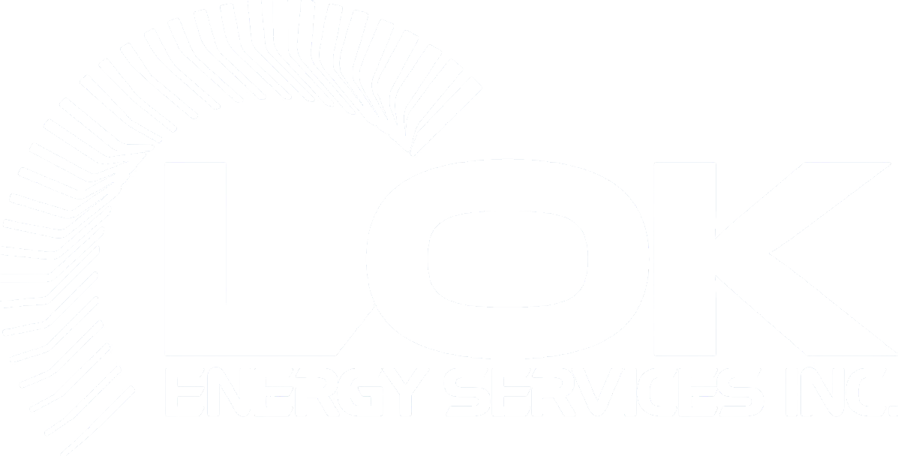

Technical Brief
Chemical Cleaning · Lube & Hot Oil Flushing · Nitrogen Services · Qualified Personnel
Chemical Cleaning
Lube & Hot Oil Flushing
Nitrogen Services
Engineering-grade execution backed by certified field personnel
CAPABILITIES
LOK Energy Services Inc. · lokenergy.com · Houston, TX · Calgary, AB

Slide 2
CHEMICAL CLEANING · OVERVIEW
CAPABILITIES
CHEMICAL CLEANING
A High-Precision Process for Critical Industrial Assets
Industrial chemical cleaning utilizes engineered chemical solutions to eliminate scale, corrosion, hydrocarbons, and biological fouling from critical process equipment — restoring flow efficiency, heat transfer performance, and structural integrity.
WHAT CHEMICAL CLEANING REMOVES
STRATEGIC VALUE
Scale & Mineral Deposits
Calcium carbonate, silica, and sulfate scale that restrict flow and impair heat transfer in exchangers and boilers.
Reduced Operating Costs
Clean systems require less energy to maintain flow and heat exchange — directly reducing utility consumption.
Hydrocarbons & Varnish
Polymerized oil residues and varnish in compressors, turbines, and lube oil circuits that cause mechanical failure.
Asset Life Extension
Removing corrosive deposits prevents localized pitting and structural degradation, extending equipment service life.
Corrosion Products
Iron oxide, rust, and mill scale from piping and vessels that accelerate further corrosion and clog filtration systems.
Turnaround Efficiency
Deep cleaning during planned outages ensures the facility returns to full capacity immediately upon restart.
Biological Fouling
Biofilm and microbial deposits in cooling water systems and pipelines that reduce efficiency and create MIC risk.
Safety Risk Mitigation
Eliminating H2S pockets and reducing pressure buildup caused by blockages improves overall site safety.
LOK Energy Services Inc. · lokenergy.com · charles@lokenergy.com · +1 (832) 781-1644

Slide 3
CHEMICAL CLEANING · EXECUTION PROCESS
CAPABILITIES
THE SYSTEMATIC SIX-STAGE PROCESS
LOK Energy Services executes every chemical cleaning project through a rigorous six-stage model — ensuring complete remediation from initial access through full system restart.
01
Access & Isolation
02
Pre-Cleaning Assessment
03
Chemical Application
The target system is physically isolated from the broader facility to ensure cleaning chemicals remain contained within the intended scope. All isolation points are documented and verified.
Technicians evaluate the type and volume of deposits to determine the specific chemical concentration, application method, and contact time required for complete remediation.
Engineered solutions are introduced into the system, tailored to both the metallurgy of the asset and the specific contaminant present — whether scale, varnish, biofilm, or oxide.
04
Circulation & Soak
05
Flushing & Neutralization
06
Inspection & Restart
Chemicals are circulated at specific velocities or allowed to soak to ensure total penetration and breakdown of deep-seated fouling — including deposits on internal pipe walls and heat transfer surfaces.
The system is flushed to remove dissolved contaminants, then chemically neutralized to stabilize metal surfaces and prevent post-cleaning corrosion or flash rust.
Final inspections verify cleanliness standards — including coupon analysis, visual inspection, and flow verification — before the equipment is cleared for operational restart.
LOK Energy Services Inc. · lokenergy.com · charles@lokenergy.com · +1 (832) 781-1644

Slide 4
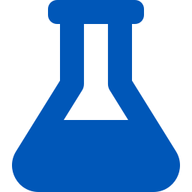



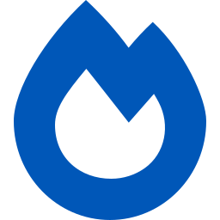
CHEMICAL CLEANING · ASSET-SPECIFIC APPLICATIONS
CAPABILITIES
ASSET-SPECIFIC REMEDIATION
Each industrial asset accumulates distinct contamination profiles. LOK applies specialized chemical approaches matched to the asset type, metallurgy, and contaminant to maximize removal efficiency and protect base metal.
Heat Exchangers
Pipelines
Vessels & Reactors
Scale & Fouling Removal
Wax, Scale & Biofilm
Deep Corrosion & Deposits
Chemical descaling restores thermal conductivity by dissolving calcium, silica, and biological fouling from tube bundles and shell surfaces — recovering full heat transfer performance without mechanical damage.
Targeted chemical treatment removes wax, mineral scale, and biofilms that restrict flow in gathering systems, production lines, and injection networks — restoring full throughput capacity.
Concentrated chemical application removes heavy iron oxide, scale, and process deposits from vessel internals and reactor beds — including passivation to protect cleaned surfaces from re-oxidation.
Compressors
Boilers
Hydrocarbon & Varnish
Scale Removal & Passivation
Specially formulated solvent and chemical solutions remove polymerized hydrocarbon varnish from compressor internals, valve assemblies, and cooling passages — preventing mechanical binding and seal degradation.
Acid or chelant-based descaling removes carbonate and silicate scale from boiler tubes, followed by a critical passivation step using neutralizing amines to protect bare metal surfaces from corrosion at restart.
LOK Energy Services Inc. · lokenergy.com · charles@lokenergy.com · +1 (832) 781-1644

Slide 5


LUBE OIL & HOT OIL FLUSHING · OVERVIEW
CAPABILITIES
LUBE OIL & HOT OIL FLUSHING
Achieving ISO 4406 Cleanliness — Protecting Rotating Equipment from Commissioning Day One
High-velocity lube oil and hot oil flushing are critical pre-commissioning and post-repair procedures that ensure rotating equipment meets strict ISO cleanliness codes before startup, preventing premature mechanical failure and protecting asset warranties.
Contaminant Removal
Mechanical Protection
Performance Optimization
Dislodge and remove particulate matter, construction debris, and varnish from internal piping surfaces, reservoirs, and lube oil circuits at turbulent flow velocities.
Eliminate contaminants that cause premature failure of mechanical seals and bearings — components highly sensitive to particulate intrusion during initial operation.
Clean systems reduce friction and wear from startup, ensuring critical equipment operates at peak design efficiency and meets OEM warranty requirements from day one.
THE FLUSHING PROCESS
High-Velocity Turbulent Flow
Thermal Application (Hot Oil)
Multi-Stage Filtration
External high-flow pump skids circulate oil at velocities significantly above normal operating rates — creating turbulent (high Reynolds number) flow to physically dislodge stubborn particulates from pipe walls.
Heating the oil reduces viscosity, further increasing turbulence and improving the fluid's ability to dissolve and carry away hydrocarbon deposits and varnish from internal surfaces.
As oil circulates, it passes continuously through high-efficiency, multi-stage filtration units — capturing suspended contaminants and progressively improving system cleanliness toward ISO target.
LOK Energy Services Inc. · lokenergy.com · charles@lokenergy.com · +1 (832) 781-1644

Slide 6
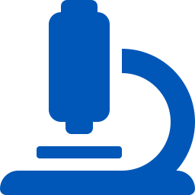
LUBE OIL FLUSHING · INTEGRATED DIAGNOSTICS
CAPABILITIES
INTEGRATED PREDICTIVE MAINTENANCE
A bulletproof flushing program goes beyond circulation — it integrates real-time diagnostics to validate cleanliness, detect anomalies, and produce auditable documentation of ISO compliance.
Oil Analysis
Vibration Monitoring
Thermal Imaging
ISO 4406 Cleanliness Verification
Mechanical Integrity During Flush
Dead-Leg & Cold-Spot Identification
Real-time fluid sampling and laboratory analysis verify that circulating oil has reached the required ISO 4406 cleanliness standard. Particle counts are measured electronically at defined intervals — providing objective, auditable proof of system cleanliness before shutdown.
Vibration analysis is conducted during the high-velocity flushing phase to detect any imbalances or resonance conditions that may develop within the system. Early detection prevents damage to bearings, seals, and rotating components during the process.
Infrared thermal imaging identifies cold spots and 'dead legs' in the piping system — zones where oil may not be circulating effectively. These areas are then targeted with additional flushing or temporary bypass circuits to ensure a comprehensive, complete system clean.
Target: ISO 16/14/11 or per OEM specification
Monitors: bearing temperature, seal integrity, resonance
Application: identifies non-circulating zones in real time
ISO 4406 CLEANLINESS STANDARD
ISO 4406 defines fluid cleanliness by counting particles at three size thresholds (≥4μm, ≥6μm, ≥14μm) and assigning ISO range numbers to each. Most OEM specifications for turbines, pumps, and compressors require cleanliness levels of ISO 16/14/11 or better. LOK's filtration systems and real-time particle counters continuously verify compliance until the target is achieved and documented.
LOK Energy Services Inc. · lokenergy.com · charles@lokenergy.com · +1 (832) 781-1644

Slide 7
NITROGEN SERVICES · DELIVERY METHODS
CAPABILITIES
NITROGEN SERVICES
Two Delivery Methods — Matched to Project Pressure, Purity & Volume Requirements
METHOD 1
METHOD 2
On-Site Membrane / PSA Generation
Nitrogen Pumping — Cryogenic to Gaseous
Ambient air is compressed and passed through hollow-fiber membranes. Oxygen and water vapor permeate faster than nitrogen — allowing high-purity N2 to be collected at discharge. PSA (Pressure Swing Adsorption) units provide higher-purity output.
Liquid nitrogen (LIN) at -320°F is transported and converted to high-volume gas using a cryogenic pump and vaporizer unit. A centrifugal cryogenic pump boosts liquid pressure, and a heat exchanger gasifies the nitrogen — using engine coolant or waste heat for conversion.
Purity Range
95% – 99.9%
Max Pressure
Up to 15,000 PSI
Flow Rate
100 – 3,000+ SCFM
Delivery Temp
Ambient to 180°F (heated)
Pressure
100 – 500 PSI
Flow Rate
Highest available — rapid displacement
Best For
Long-term blanketing, continuous purging, projects avoiding cylinder logistics
Best For
High-pressure leak testing, rapid system displacement, wellbore applications
LOK Energy Services Inc. · lokenergy.com · charles@lokenergy.com · +1 (832) 781-1644

Slide 8
NITROGEN SERVICES · INDUSTRIAL APPLICATIONS
CAPABILITIES
CORE INDUSTRIAL APPLICATIONS
Nitrogen's inert properties make it essential across well remediation, commissioning, turnaround, and integrity testing — at pressures from low-volume blanketing to 15,000 PSI wellbore tests.
Purging & Pigging
Pneumatic Leak Testing
Accelerated Cooling
Displacing hazardous hydrocarbons or oxygen from pipelines and vessels to reach a Lower Explosive Limit (LEL) safe for hot work or confined space entry. Required before any maintenance on live systems.
Using nitrogen's inert properties to pressure-test systems to 1.1× or 1.5× of Maximum Allowable Working Pressure (MAWP) — without the oxidation or moisture contamination risk of air or water testing.
High-volume nitrogen flow rapidly cools reactors and catalyst beds during turnarounds — significantly reducing the cooling phase window and compressing overall turnaround duration.
Drying & Inerting
H2S & Gas Mitigation
Commissioning Support
Removing moisture from systems by achieving low dew points — preventing hydrate formation in pipelines, catalyst poisoning in reactors, and oxidation in vessels before startup or during preservation.
Nitrogen displacement and inerting to safely mitigate H2S, methane, and other hazardous gases from wellbores, vessels, and confined spaces prior to entry or hot work — reducing worker exposure risk.
Nitrogen services integrated into commissioning workflows — pre-startup inerting, system pressure checks, first-fill support, and leak testing across new and reactivated wells and process systems.
LOK Energy Services Inc. · lokenergy.com · charles@lokenergy.com · +1 (832) 781-1644

Slide 9
QUALIFIED PERSONNEL · CORE CLASSIFICATIONS
CAPABILITIES
CORE PERSONNEL CLASSIFICATIONS
A bulletproof industrial operation depends on the technical bridge between specialized equipment and human expertise. In chemical cleaning, nitrogen services, and hot oil flushing, the caliber of personnel is the primary safeguard.
Engineered Chemical Technicians
Pipeline & Nitrogen Field Operators
Chemical Cleaning Operations
Nitrogen Services & High-Pressure Operations
Specialized in reactive chemistry handling and application. Proficient in stoichiometry, metallurgy compatibility, and neutralization protocols — managing injection rates and titration of cleaning agents during boiler passivation and heat exchanger remediation to ensure contaminant removal without base-metal loss.
Highly trained in cryogenic safety and high-pressure fluid dynamics. Manage high-pressure iron, cryogenic pump operation, and pigging logistics — calculating volume displacement and monitoring flow rates during purging operations to maintain inert atmospheres and verify system integrity under MAWP.
Lube Oil & Flushing Specialists
Certified Craft Labor
Lube Oil & Hot Oil Flushing
Welders, Pipefitters & Field Fabricators
Precision flushing technicians operating high-flow pump skids and multi-stage filtration systems. Trained in ISO 4406 cleanliness verification, real-time particle counting, and the interpretation of oil analysis results — ensuring flushing programs achieve and document target cleanliness before equipment startup.
AWS/ASME-certified welders and pipefitters providing the structural foundation for temporary flushing loops, chemical circulation jumpers, and permanent process piping repairs. Skilled in precision ISO-drawing interpretation and the fabrication of custom temporary connections required for complex service scopes.
LOK Energy Services Inc. · lokenergy.com · charles@lokenergy.com · +1 (832) 781-1644

Slide 10
QUALIFIED PERSONNEL · TECHNICAL QUALIFICATIONS
CAPABILITIES
TECHNICAL QUALIFICATIONS & STANDARDS
Beyond manual labor — validated competence at every level. LOK personnel are trained, certified, and continuously field-proven across Oil & Gas, Power Generation, and Petrochemical environments.
20+ Years Experience
SAFETY & COMPLIANCE — READY TO WORK
Core team leads and supervisors carry over 20 years of industrial field experience — bringing OEM-level familiarity with turbines, compressors, pumps, and process systems.
LOTO / Lockout-Tagout
Full certification in energy isolation procedures — a non-negotiable requirement for any chemical cleaning, flushing, or nitrogen service scope.
OEM Compliance
All work is performed within OEM maintenance manuals and tolerance specifications — ensuring equipment warranties remain intact and post-service performance meets design ratings.
Confined Space Entry & Rescue
All relevant personnel hold confined space entry and rescue certification — enabling safe execution in vessels, tanks, and enclosed piping systems.
Multi-Disciplinary Expertise
H2S Awareness
Cross-training in NDT, thermal imaging, vibration analysis, and oil analysis allows field staff to provide real-time diagnostic feedback — not just execution.
Every crew member carries current H2S Alive or equivalent certification — ensuring safe operation in hydrocarbon-bearing and sour service environments.
Cryogenic Safety
Red Seal & Journeyman Certification
Nitrogen field operators are trained in cryogenic liquid handling, personal protective equipment requirements, and emergency response for LIN spills and pressure events.
Craft personnel are vetted against trade certifications including Red Seal (Canada), Journeyman, and AWS/ASME welding qualifications prior to deployment.
Permit Leadership
Supervisors act as the primary interface for site-specific permit requirements — ensuring every JSA is technically accurate and every hot-work permit is properly managed.
LOK Energy Services Inc. · lokenergy.com · charles@lokenergy.com · +1 (832) 781-1644

Slide 11
QUALIFIED PERSONNEL · QUALITY CONTROL MODEL
CAPABILITIES
THE LOK SIX-STAGE QUALITY CONTROL MODEL
Every LOK deployment — chemical cleaning, nitrogen services, or lube oil flushing — is governed by a standardized six-stage quality control model that ensures consistency, accountability, and documented results.
01
Selection
02
Briefing
03
Execution
Personnel are vetted and selected based on specific trade certifications (Red Seal, Journeyman, AWS/ASME) and directly relevant field experience for the service scope being executed.
Detailed review of P&IDs (Piping & Instrumentation Diagrams), scope of work, and site-specific safety requirements — ensuring every crew member understands the system before touching equipment.
Real-time monitoring of critical parameters — flow rates, pressures, temperatures, particle counts, and chemical concentrations — throughout the active service phase.
04
Verification
05
Documentation
06
Demobilization
Objective cleanliness or performance verification using laser particle counters (for oil flushing), titration kits (for chemical cleaning), or pressure gauges (for nitrogen testing).
Detailed reporting of all clearances, pressures, volumes, particle counts, and chemical parameters — providing the client with a complete, auditable record of work performed.
Safe and complete restoration of the site to operational status — including removal of all temporary equipment, reinstatement of isolation points, and final system handover to operations.
LOK Energy Services Inc. · lokenergy.com · charles@lokenergy.com · +1 (832) 781-1644

Slide 12




CAPABILITIES
The LOK Difference
Chemical Expertise
Flushing Precision
Nitrogen Capability
Personnel Standards
Engineered solutions matched to your metallurgy, contamination type, and asset — not generic chemistry.
ISO 4406 compliance verified by real-time particle counters and thermal imaging — documented proof of cleanliness.
On-site membrane generation to 15,000 PSI cryogenic pumping — the full spectrum of nitrogen delivery.
20+ years of experience, OEM-compliant, LOTO/H2S/cryogenic certified, and site-ready from day one.
USA — HOUSTON charles@lokenergy.com · +1 (832) 781-1644 · 8308 Millet St, Houston TX 77012 | CANADA — CALGARY support@lokenergy.com · +1 (403) 214-4394

Slide 13
